Slide 1



TI 2-4 GALVAN COVARRUBIAS VICTOR MANUEL
Oral presentation
English II
Teacher Cinthya Rivera Diaz

Slide 2
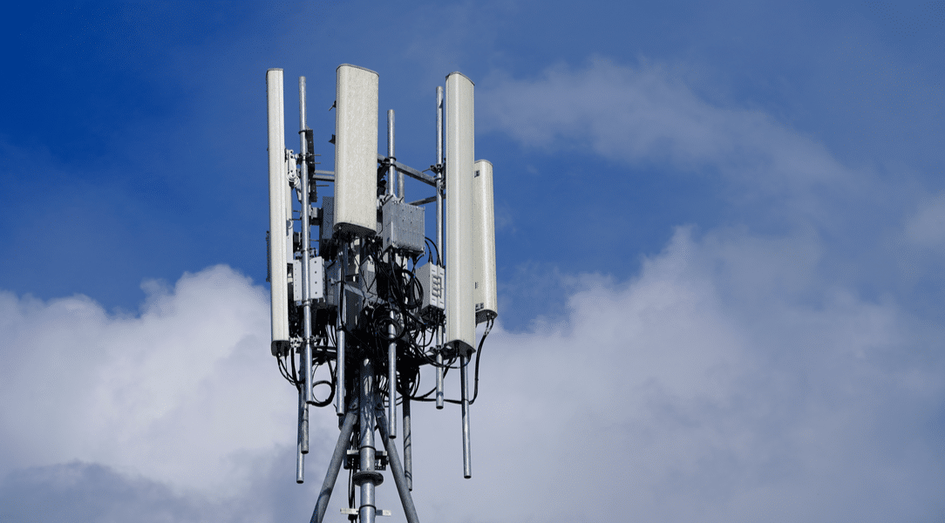
5G antenna
2008
First antenna 20013
IOT

Slide 3
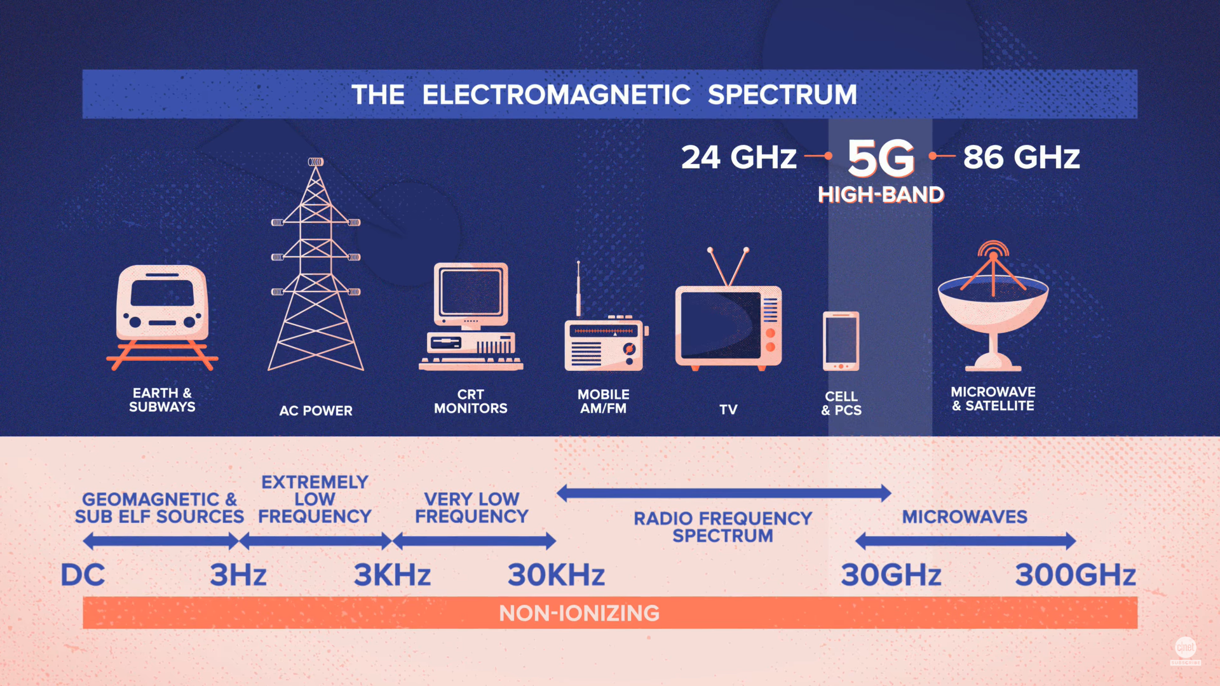
Frequency spectrum

Slide 4
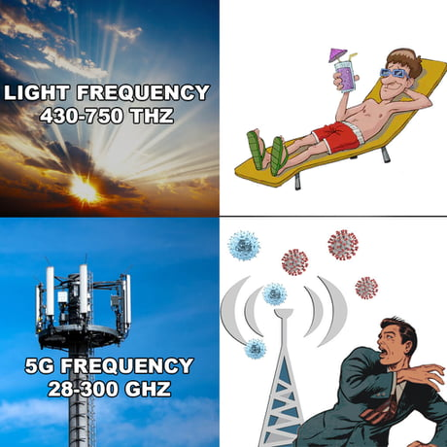
Comparison of damage
An arm x-ray.
Using a electronics for a Year.
Flight of 8 hours.

Slide 5
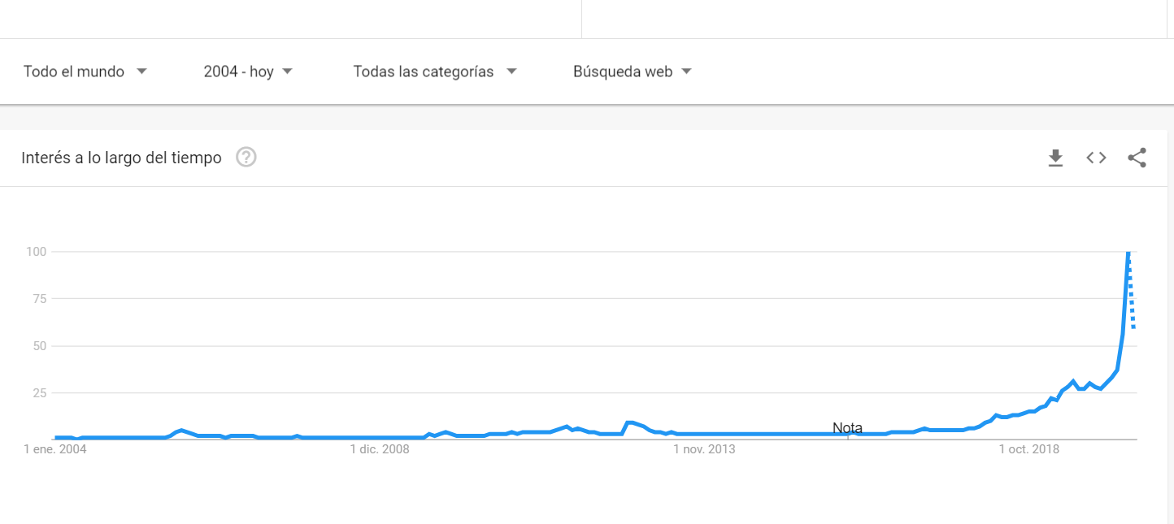
Google trends

Slide 6
